Slide 1
Study Guide
Nature of Math
Test 2

Slide 2
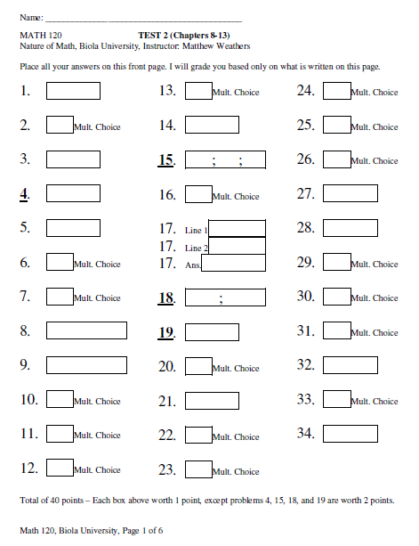
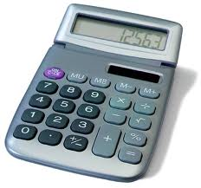
About the Test
34 Questions
20% of Semester Grade
Calculator Okay
75 minutes
Sample Questions in Appendix

Slide 3
Suggestions
Look through sample questions
Get enough sleep
Visit Math Lab
Study with friends

Slide 4
Topics
Averages & Weighted Averages
Counting Combinations
Algebra: Multiplying / Combining Like Terms
Different Bases
Whole Number base conversions
Decimal / Fraction conversions (Not on test)
Mayan Numbers – Normal & Solar Numbers
Unknown Bases / Finding Numbers
Using Exponents

Slide 5
Averages
Ordinary Average
Add the numbers
Divide by the number of numbers

Slide 6
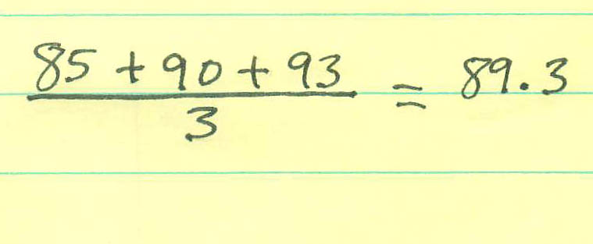

Slide 7
Averages
Weighted Average
Multiply each number by its weight
Add
Divide by the total weight

Slide 9
Averages
Average Speed
Determine distance for each part
Total Distance / Total Time

Slide 11
Counting Combinations
“Basic Counting Principle”
Count ways things can be done
Multiply

Slide 12
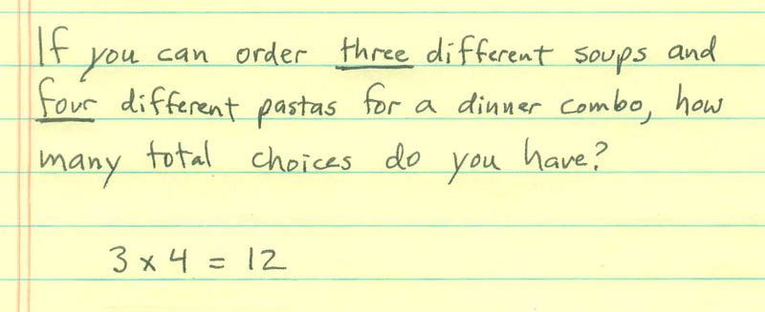

Slide 13
Bases – Whole Numbers
Converting from Base 7 to Base 10
Determine Place values for each place
Add up the digits

Slide 14
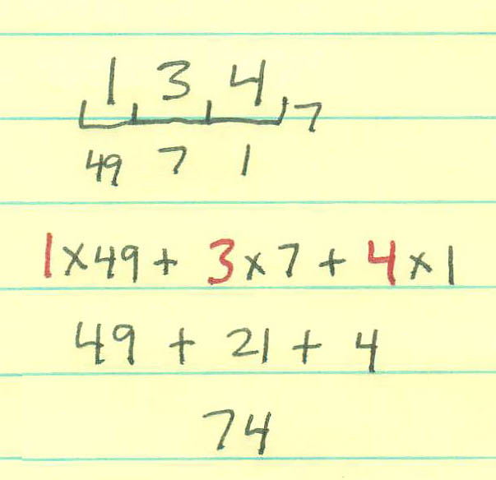

Slide 15
Bases – Whole Numbers
Converting to a different Base
Determine place values then guess
Repeated long division

Slide 16
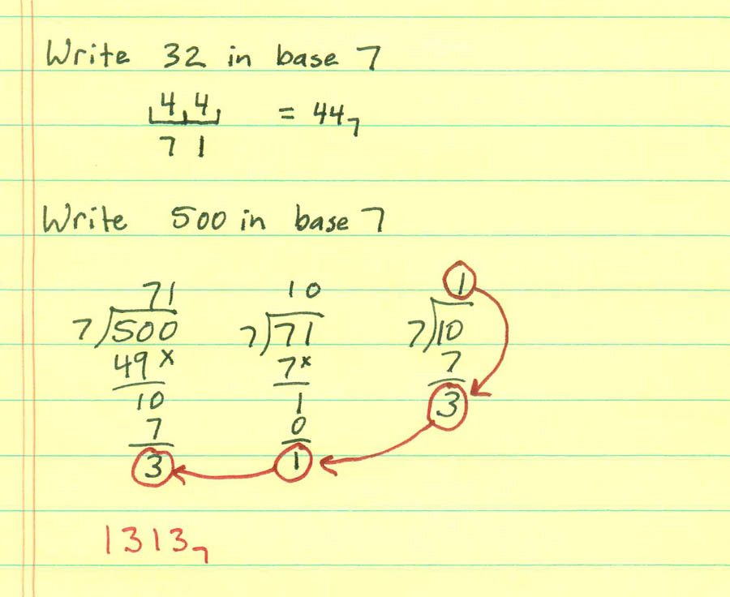

Slide 17
Bases – Arithmetic
Addition
Multiplication

Slide 18
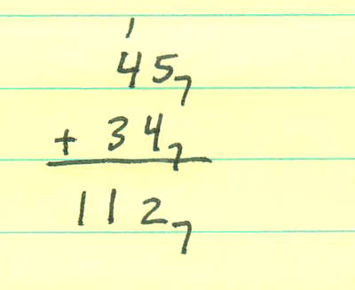

Slide 19
Bases – Unknown
Number written in unknown base
Unknown number (Chinese Remainder Theorem)

Slide 20
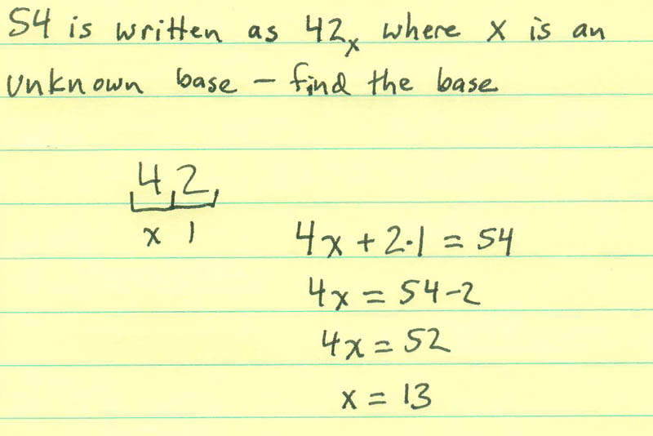

Slide 21
Bases – Unknown
Number written in unknown base
Unknown number (Chinese Remainder Theorem)

Slide 23
Mayan Numbers
Base 20
Digits written as: 5 = | and 1 = .
“Common” Mayan: 400 / 20 / 1
“Solar” Mayan: 360 / 20 / 1

Slide 24
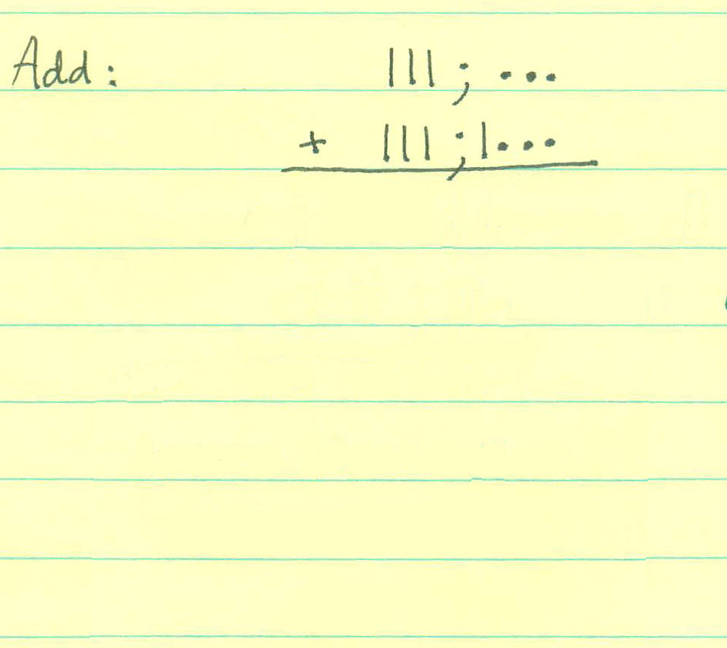

Slide 25
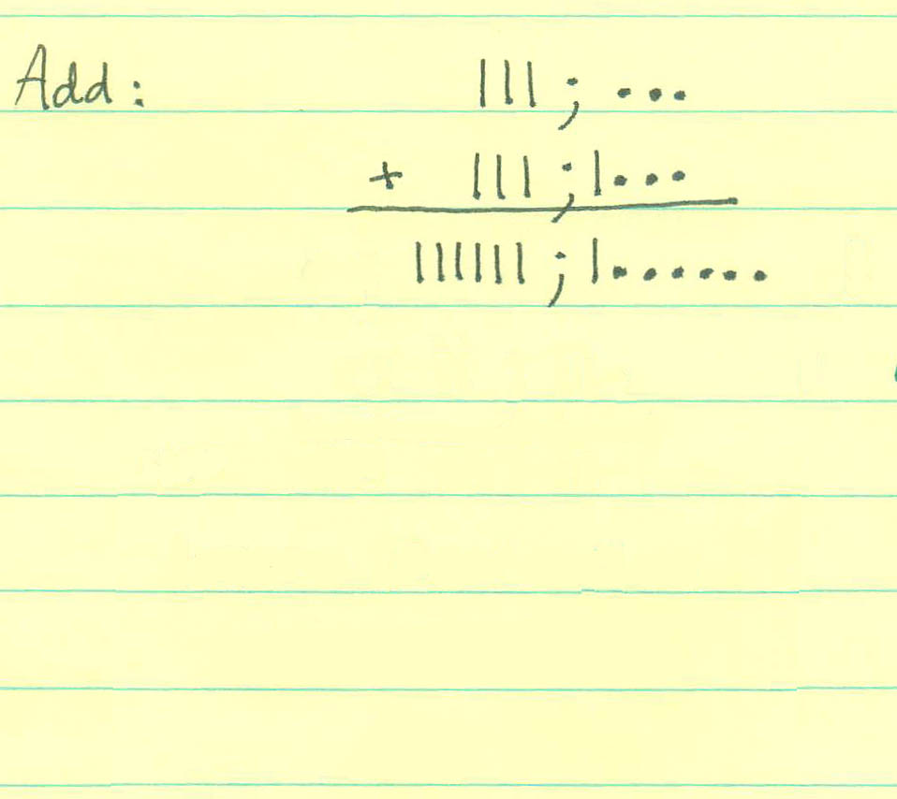

Slide 26
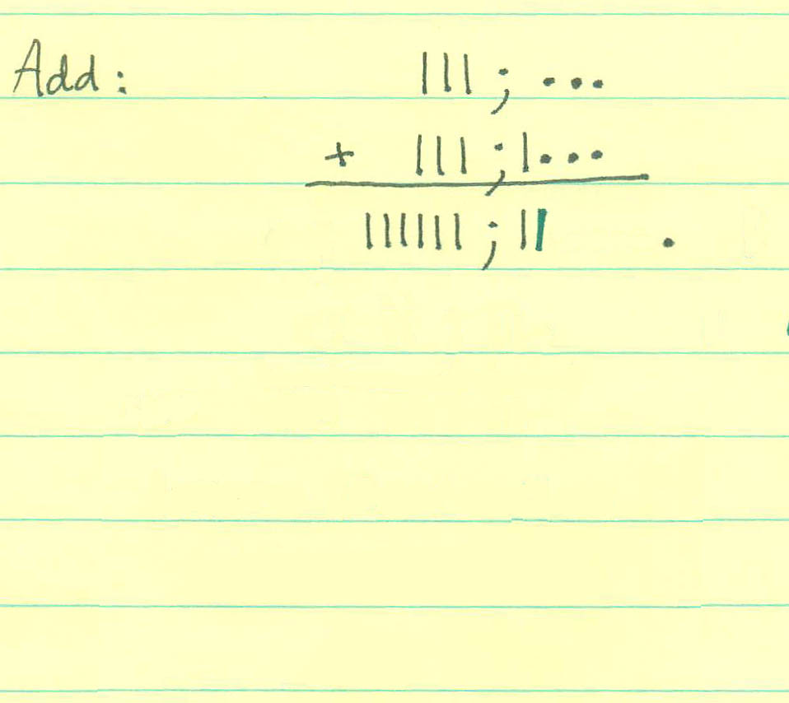

Slide 27
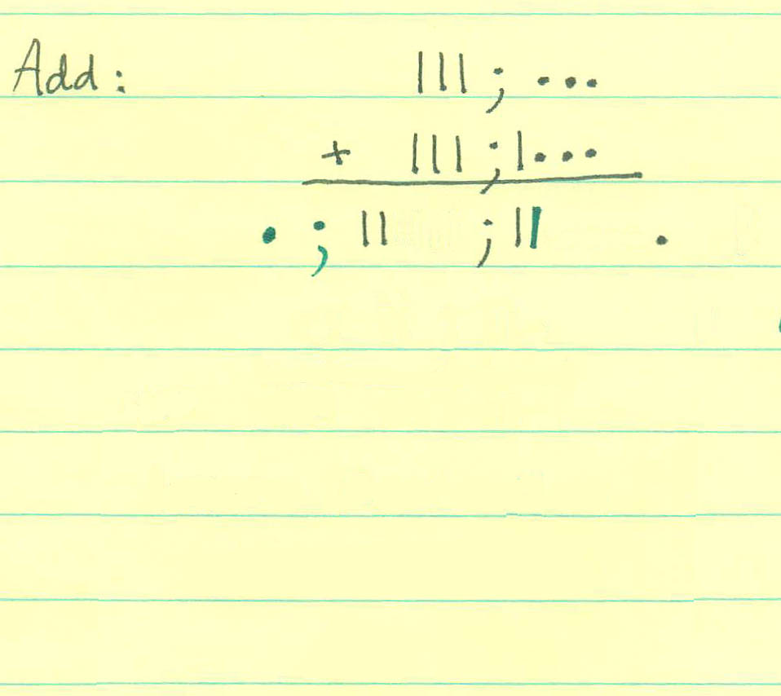

Slide 28
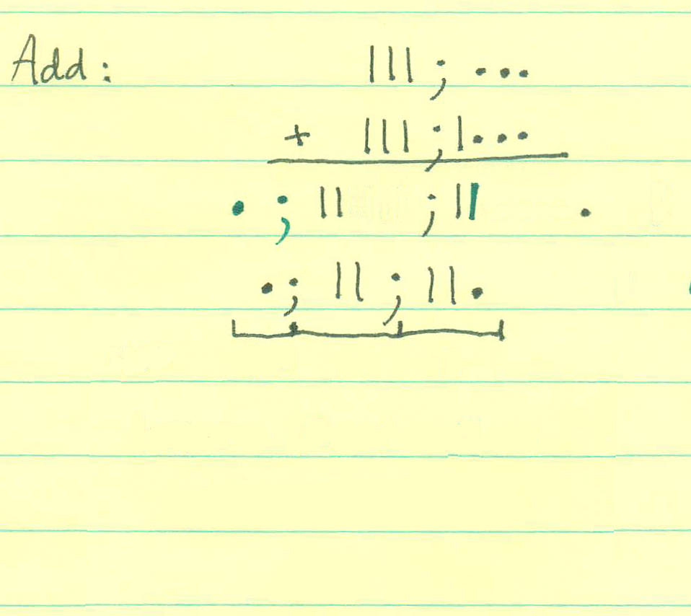

Slide 29
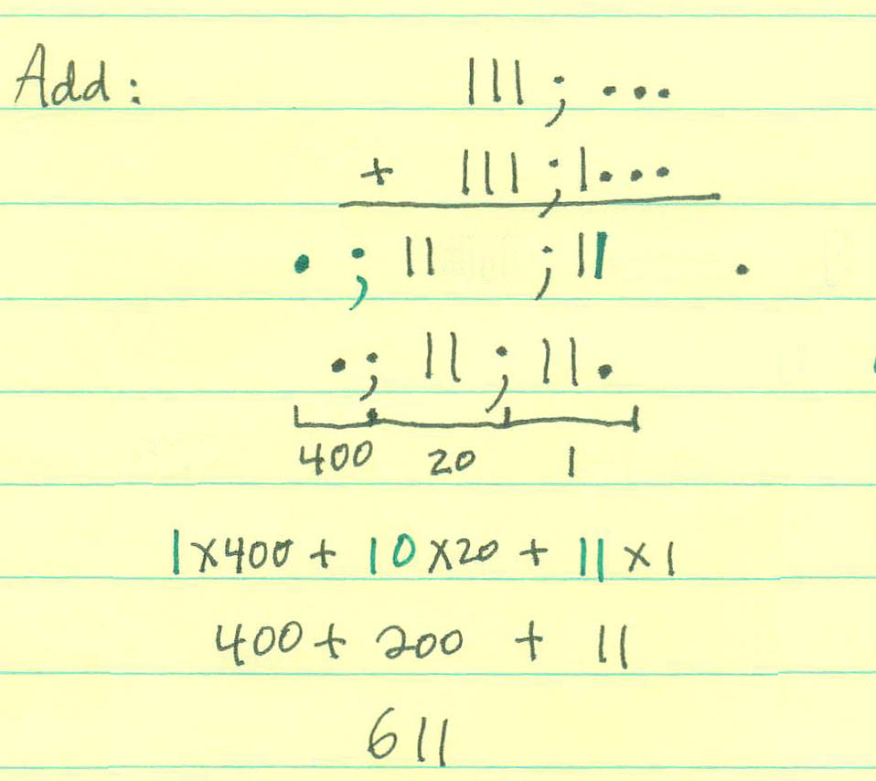

Slide 30
Exponents

Slide 31
Exponents

Slide 32
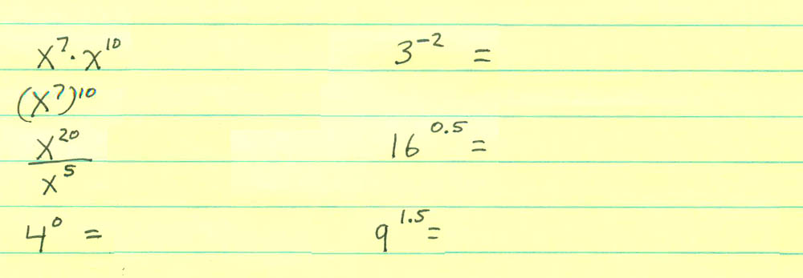

Slide 33
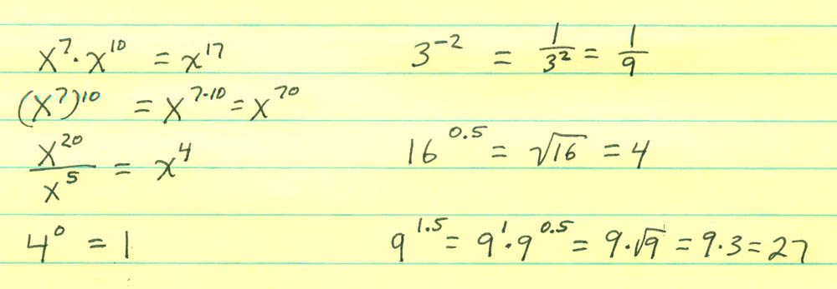

Slide 34
Exponents – Larger Exponents
Addition 8+10
Multiplication 8x10
Exponents 8¹⁰
Arrow Notation 8↑↑10
Arrow Notation 8↑↑↑10
(This list goes from smaller to larger)

